Slide 1
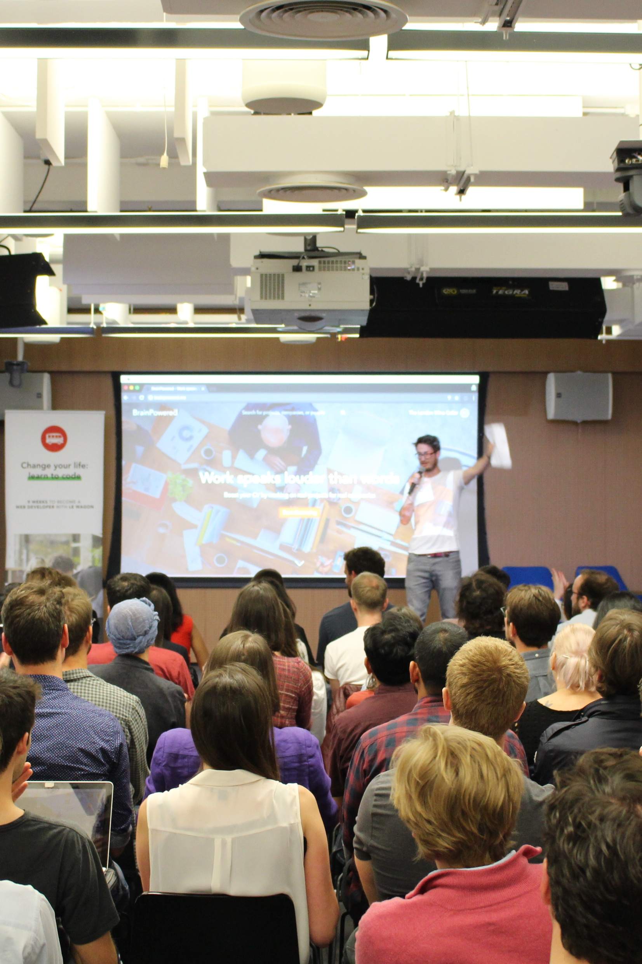

Pitch prep.
FAQ on Pitches / Projects

Slide 2


Projects week
Week 8 & 9

Slide 3


How do
projects
work?
- Teams of 3 or 4
- 2 to 3 projects
- One goal: LEARN

Slide 4
Pitch time
Saturday, June 27 2020

Slide 5
FAQ for
After one
After all
pitch
time.
pitch.
pitches.
Vote from 1 to 5
15 min to discuss
- 3 min pitches
- 3 slides (target, pain, solution)

Slide 6
Teams formed based on votes.
Historical average
> 80% get their 1st or 2nd choice

Slide 7
What’s a good project?
Make the most of week 8 & 9
How to choose the WeChat app to work on!

Slide 8

What makes a final project
good
Avoid marketplaces ⛔️
Interactive features 💪
Xiaohongshu week 7 / Boring
Live interaction, video, etc.
Creativity possible 🤩
Simple user journey 👩‍💻
Admin == Boring frontend
Few pages, fast conversion

Slide 9
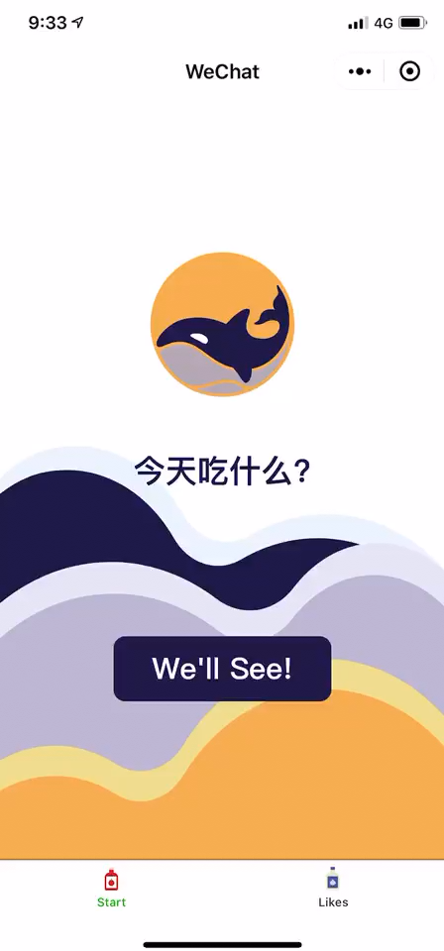

Notes:
https://drive.google.com/file/u/1/d/1sA1dZ4b76o42JQEhT8-lcS_1z8Va035D/view?usp=drive_open
https://v.qq.com/x/page/k0976g2p7eo.html

Slide 10
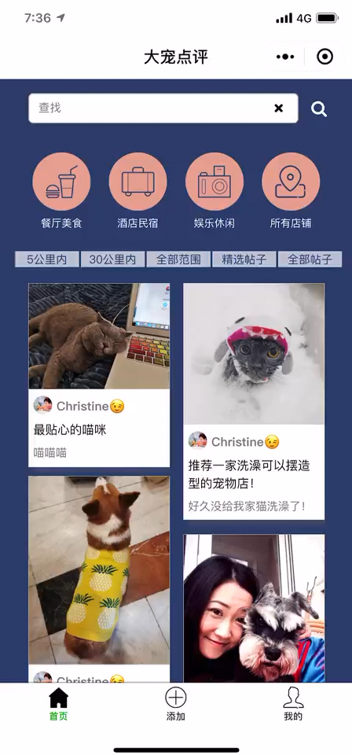
Notes:
https://drive.google.com/file/d/1NA0WD58fdIJsWN7OJQybKo-X-oxcBoaO/view
https://v.qq.com/x/page/p0976oui3y2.html

Slide 11
So, what
Features
can I make?
Product pages
Conversion
Price, Votes, Photos…
Forms, Bookings, Cart, Payment…
Index pages
User pages
Maps, Lists, Search, Filters…
Account, Points, Settings…

Slide 12
What’s a good pitch?
Make your pitch stand out!

Slide 13
What makes a pitch
good
Obvious pain 🤕
Short slides 🤯
Makes a clear product
Say it rather than write it!
Be passionate 🤩
Core vision 🔭
People will believe you
Explain clearly what
you want to build

Slide 14
Their
pitch.
Pain
Target
Solution
It takes a whole afternoon to find cheap flights for weekends on comparison sites.
Young professional who want to visit a specific city but don’t care which weekend.
Flight comparison app only for long weekends

Slide 15
Any
questions?

